Slide 1
Intro to Parallel Programming
Xiaoyuan Suo Webster University

Slide 2
Parallel Programming
Parallel programming is all about breaking down tasks into smaller tasks and executing them simultaneously
Threads are lightweight units of execution within a process
C++ offers std::thread for creating and managing threads, allowing different parts of a program to run concurrently

Slide 3
Shared Memory vs. Message Passing
Shared Memory:
Threads within a single process can access a common memory space
This model is often used with libraries like OpenMP, which provides directives to parallelize code sections and loops
Message Passing:
Processes communicate by sending and receiving messages
This is typically used for distributed memory systems, where processes run on different machines, and libraries like MPI (Message Passing Interface) facilitate communication

Slide 4
Benefits of Parallel Programming
In the simplest sense, parallel computing is the simultaneous use of multiple compute resources to solve a computational problem:
A problem is broken into discrete parts that can be solved concurrently
Each part is further broken down to a series of instructions
Instructions from each part execute simultaneously on different processors
An overall control/coordination mechanism is employed

Slide 5
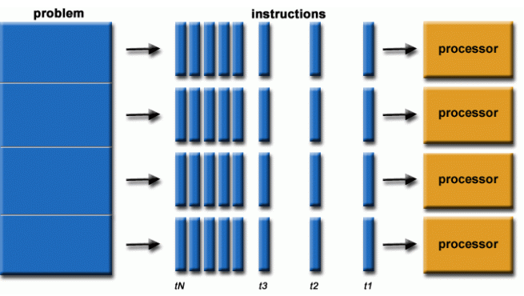
Multiple Tasks

Slide 6
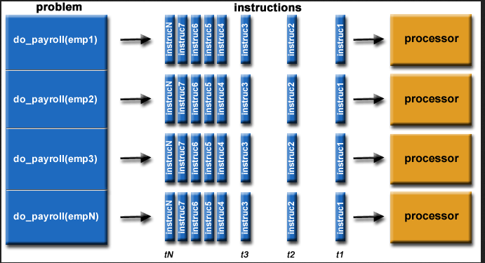
Multiple Tasks

Slide 7
Parallel Programming
The computational problem should be able to:
Be broken apart into discrete pieces of work that can be solved simultaneously
Execute multiple program instructions at any moment in time
Be solved in less time with multiple compute resources than with a single compute resource
The compute resources are typically:
A single computer with multiple processors/cores
An arbitrary number of such computers connected by a network

Slide 8
Regular Function
int sum_serial(int n)
{
int sum = 0;
for (int i = 0; i <= n; ++i) {
sum += i;
}
return sum;
}

Slide 9
Parallel Function
int sum_parallel(int n)
{
int sum = 0;
#pragma omp parallel for reduction(+ : sum)
for (int i = 0; i <= n; ++i) {
sum += i;
}
return sum;
}
Notes:
‘for’ means that the following loop is what is used by the parallel

Slide 10
Parallel Function – Another Option
int sum_parallel(int n)
{
int sum = 0;
#pragma omp parallel for
for (int i = 0; i <= n; ++i) {
sum += i;
}
return sum;
}

Slide 11

Time Improvement

